Slide 1
TNE20002 / TNE70003
Topic 6 DHCP V1.0

Slide 2
Dynamic Host Configuration Protocol (DHCP)
All devices
PCs, switches, IPhones, printers, servers etc
need an IP address
to connect to a network

Slide 3
Dynamic Host Configuration Protocol (DHCP)
Static IP addresses
Devices such as routers, servers, printers, photocopiers etc, need an address that will not change
Static address assignment is required

Slide 4
Dynamic Host Configuration Protocol (DHCP)
Dynamic IP addresses
PCs, Laptops in an organization often change locations, physically and logically:
Dynamic address assignment is required
Can use any IP address within the range of addresses in the subnet.

Slide 5
Dynamic Host Configuration Protocol (DHCP)
DHCP
Address Allocation
MAD !

Slide 6
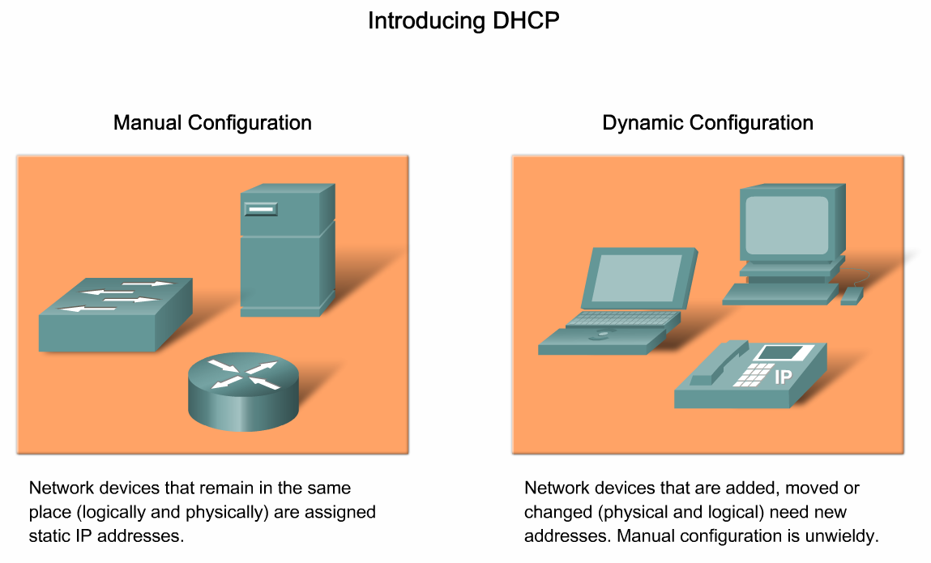
DHCP Address Allocation - MAD
Automatic
Manual
Dynamic

Slide 7
DHCP - Address Allocation Techniques - MAD
Manual
The IP address for the client is pre-allocated
by the administrator
and
DHCP conveys the IP address
to the client.

Slide 8
DHCP - Address Allocation Techniques - MAD
Automatic
DHCP selects from an address pool,
automatically assigns
a permanent IP address to a client
with no lease period.

Slide 9
DHCP - Address Allocation Techniques - MAD
Dynamic
DHCP selects from an address pool
and leases the IP address to the client
for a limited period of time.

Slide 10
Dynamic Host Configuration Protocol (DHCP)
DHCP Operation
DORA
Discover, Offer,
Request, Acknowledge
Client Action

Slide 11
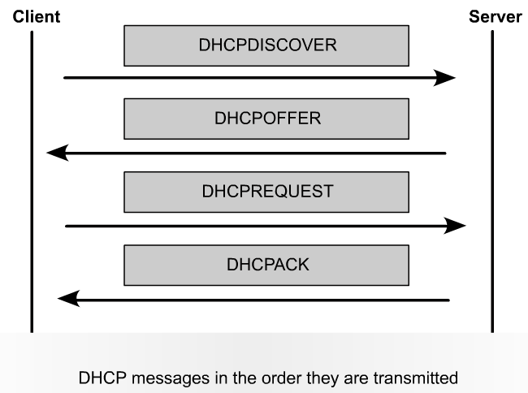
DHCP Operation – Four Messages - DORA
11
Notes:
11

Slide 12
DHCP Operation – Four Messages - DORA
DHCPDISCOVER – I would like to request an address
Broadcast
DHCPOFFER – I am server 2, Here is an address, I can offer
Unicast
DHCPREQUST – I accept the IP address offer
Broadcast
DHCPACK – Your acceptance is acknowledged
Unicast
12
Notes:
12

Slide 13
DHCP Operation – Obtaining a Lease – Discover
1. DHCP Discover (to Server)
Client (PC) broadcasts DHCPDISCOVER message
DHCPDISCOVER finds DHCP server(s)
Uses layer 2 (FF:FF:FF:FF:FF:FF) and layer 3 broadcast addresses to communicate with server(s)

Slide 14
DHCP Operation – Obtaining a Lease – Offer
2. DHCP Offer (to Client)
DHCP Server
finds available IP address to lease
creates and ARP entry in its ARP table consisting of the MAC address of requesting host and the leased IP address
Sends DHCPOFFER message to Client
Unicast using server’s layer 2 MAC address as source and client’s layer 2 MAC address as destination

Slide 15
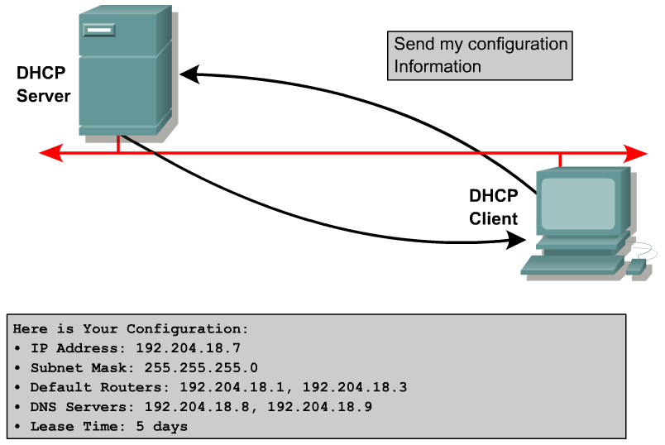
DHCP Operation - Messages Discover and Offer
1. DHCP Discover
2. DHCP Offer
Offer Details
Gateway:
15
Notes:
15

Slide 16
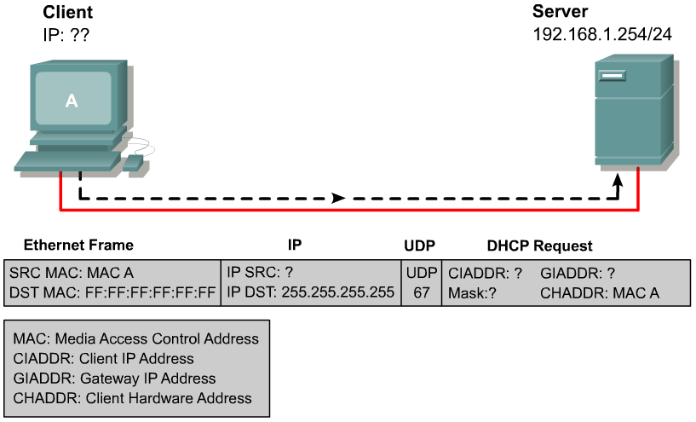
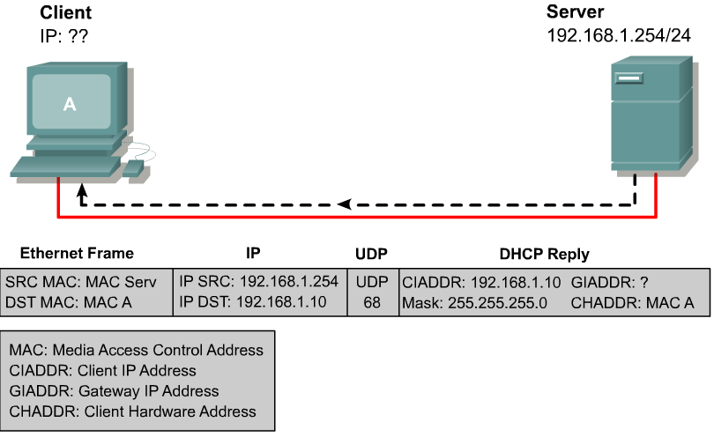
DHCP Operation – Messages Discover and Offer
DHCP on port 68
DHCP on port 67
1. DHCPDISCOVER - Broadcast
? 0.0.0.0
DHCP
DHCP
Server Port
2. DHCPOFFER - Unicast
Client Port IP address/mask
16
Notes:
16

Slide 17
DHCP – Obtaining a Lease – Request
3. DHCP Request (to Server)
Client broadcasts DHCPREQUEST message, two purposes:
Requests IP lease information be verified to ensure assignment is still valid
Serves as a binding acceptance notice to the selected server and an implicit decline to any other DHCP servers that may have given the client an offer

Slide 18
DHCP – Obtaining a Lease – Acknowledge
4. DHCP ACK (to Client)
Server replies with unicast DHCPACK

Slide 19
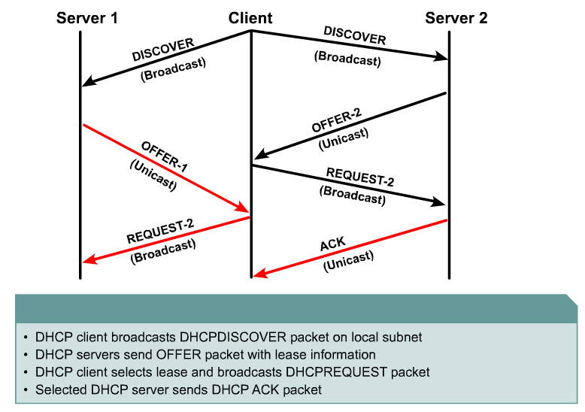
DHCP Operation – DORA Messages 1, 2, 3 and 4
1
2
3
4
19
Notes:
19

Slide 20
DHCP – Client Action
Client checks IP address is not a Duplicate within Subnet
Client sends ARP request (does any host within the subnet have this IP address ?) using new IP address
If no other hosts in subnet reply, the IP address is not a duplicate, hence it can use the IP address

Slide 21
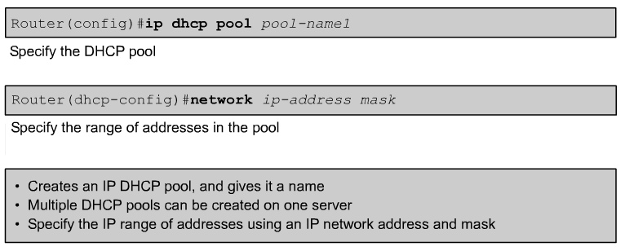
Configuring DHCP
The network statement enables DHCP on any router interfaces belonging to that network.
The router will act as a DHCP server on that interface.
It is also the pool of addresses that the DHCP server will use.
Pool NaMe (vs nAmE) is case sensitive
21
Notes:
21

Slide 22
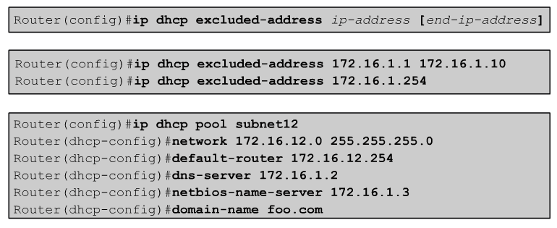
Configuring DHCP
172.16.12.1 172.16.12.10
172.16.12.254
The ip dhcp excluded-address command configures the router to exclude an
individual address or
range of addresses when assigning addresses to clients.
IP configuration values such as the default gateway can be set.
22
Notes:
22

Slide 23
Configuring DHCP – Manual Allocation
Manually allocating an IP address to a printer, photocopier etc
Router(config)# ip dhcp pool subnet12
Router(dhcp-config)# host 172.16.12.5 255.255.255.0
Router(dhcp-config)# client-identifier <unique-identifier>
The unique-identifier of the client - the printer, is specified in dotted hexadecimal notation, for example, 01b7.0813.8811.66, where 01 represents the Ethernet media type, followed by client’s MAC address
When this printer’s DHCP Client requests an IP address it will receive 172.16.12.5

Slide 24
Configuring a Cisco Router as a DHCP Server
The Enabling the DHCP service:
To enable the service:
Router(config)#service dhcp
To disable the service:
Router(config)#no service dhcp

Slide 25
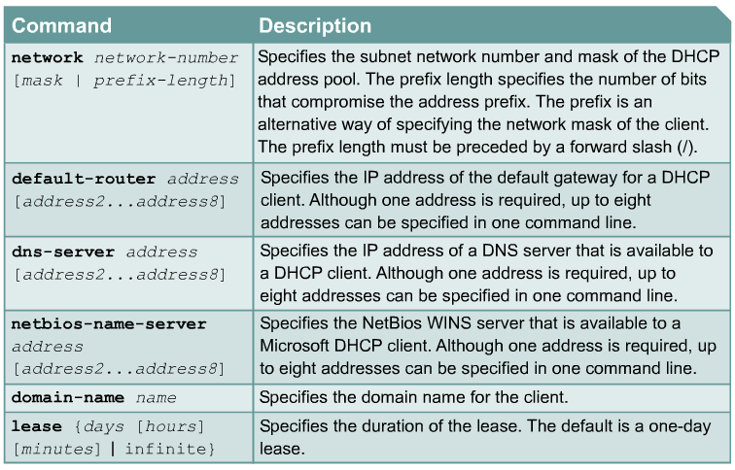
Configuring DHCP - Options
25
Notes:
25

Slide 26
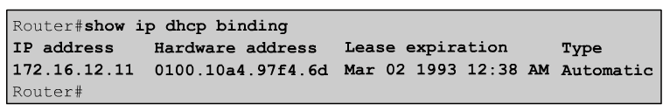
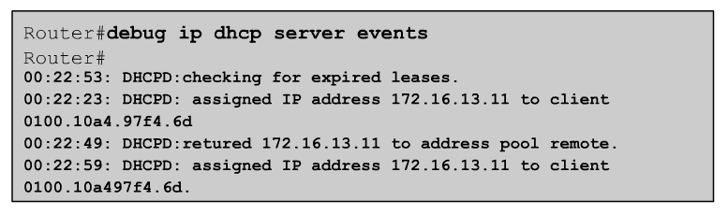
Verifying and Troubleshooting DHCP
26
Notes:
26

Slide 27
Verifying and Troubleshooting DHCP
show ip dhcp server statistics
show ip dhcp pool

Slide 28
DHCP Relay
The
DHCP Server
is in a
different
subnet

Slide 29
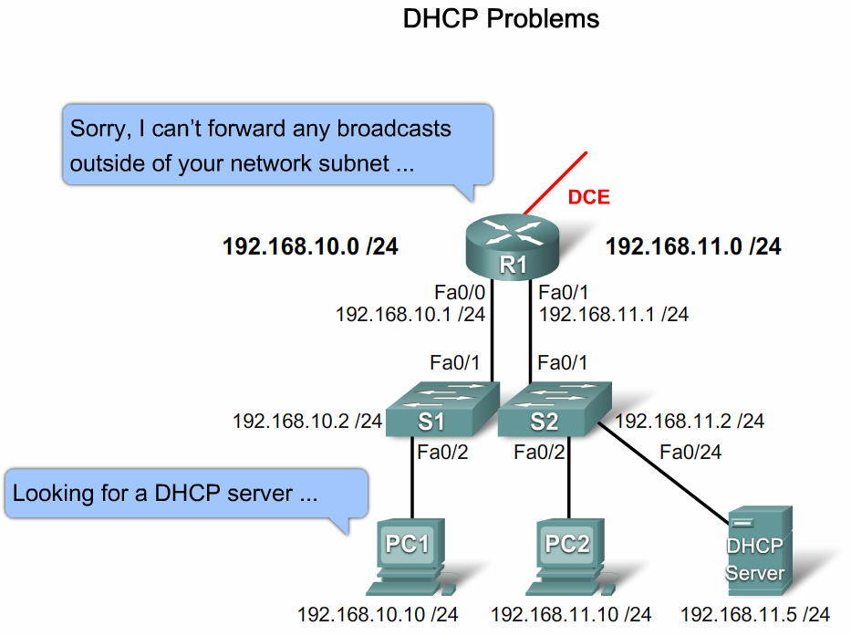
DHCP Relay – DHCP Server in a different subnet

Slide 30
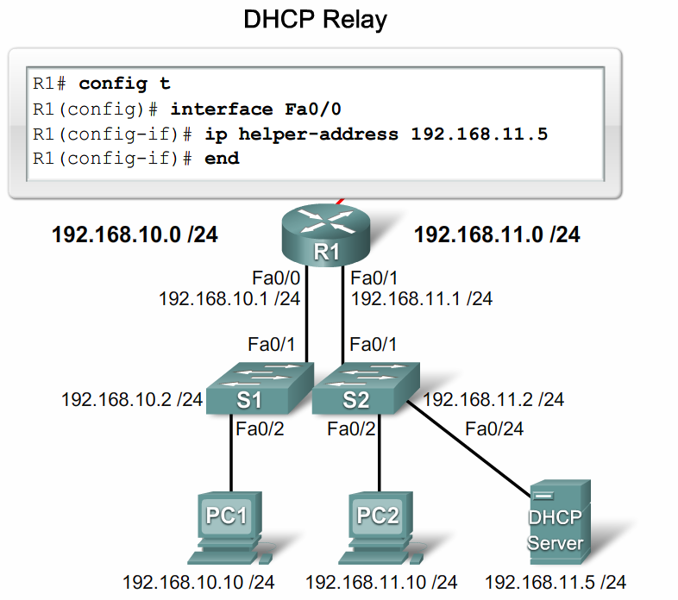

DHCP Relay – DHCP Server in a different subnet
IP address of Server

Slide 31
DHCP Explained | Step by Step - YouTube
THE END

